Slide 1























E SUMMIT 21
in association with
JU Classrooms
HACK
N
P
TCH
Campus Care
Goal Diggers
_CONNECTION ESTABLISHED
Jadavpur University
event partner
powered by
gold sponsors
WOLFRAM
Devfolio

Slide 2
Team member details
Team Name
Goal Diggers
Institute name
Jadavpur University
Team members >
1 (Leader)
2
3
4
5
Name
Abhay Bajaj
Isika Samanta
Nidhi Shah
Sanghita Gharami
HACK
N
P
TCH
Batch
IT (2020-24)
IT (2020-24)
IT (2020-24)
IT (2020-24)

Slide 3
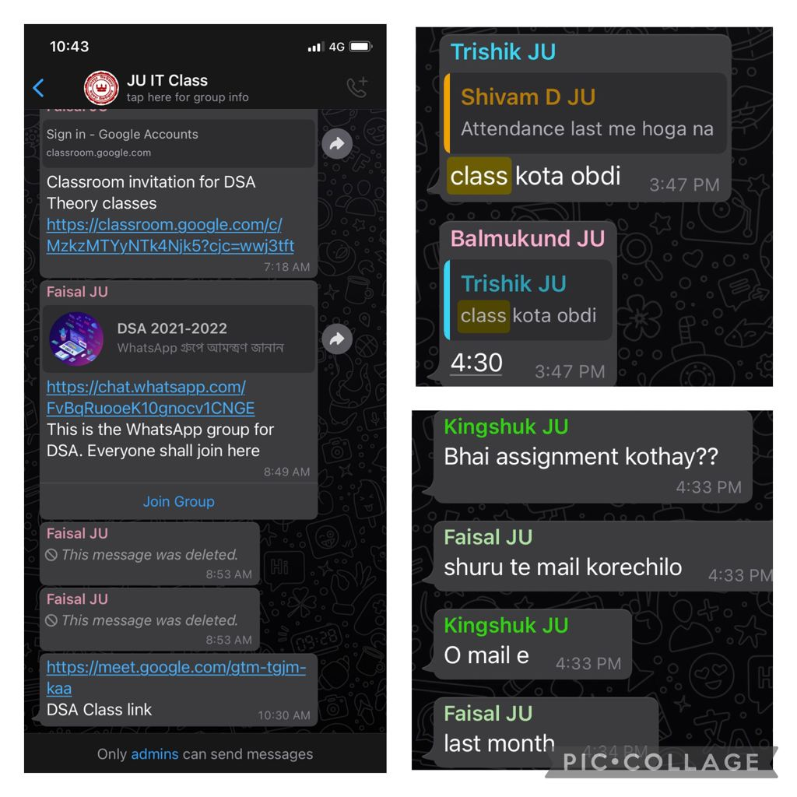
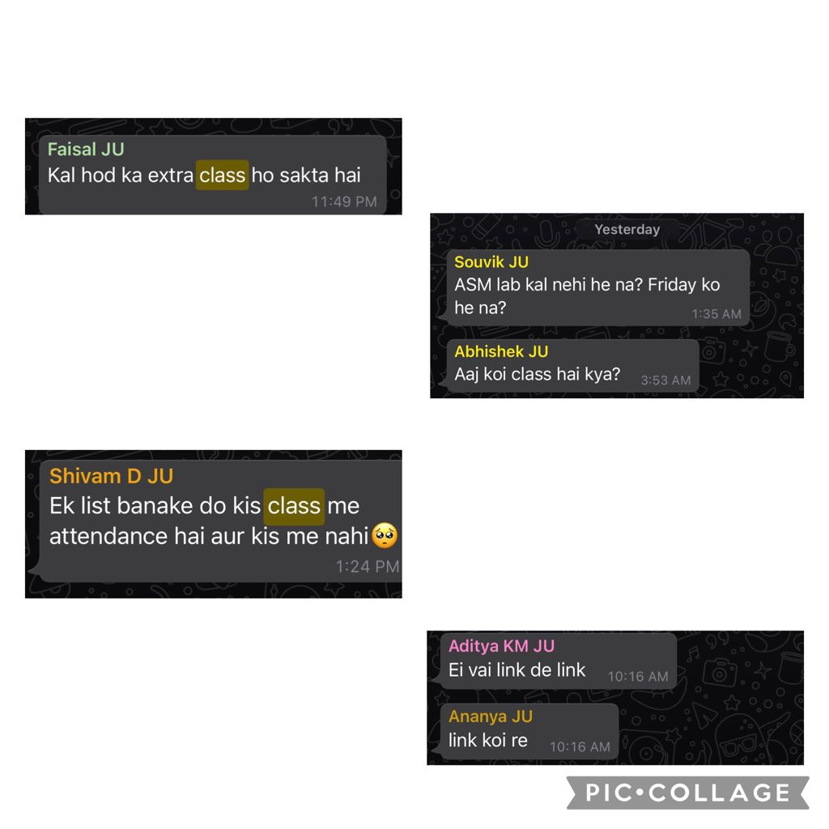
Functionalities of product
What is the product's USP?
Jadavpur University dosen’t have a G-suite and different teachers use various platforms for sending assignments/class links/tests and other related information which causes confusion among students as in the pictures.We aim to solve the issue by creating a single platform where all such details will
be available.
What is the technology used for the product?
- Are there any licensed tools being used?
Front end devlopment is being done on HTML
,CSS and Javascript.Backend devlopment is
being done on MERN stack. Some APIs are
being used which include calendly and
google calendar API.
HACK
N
P
TCH

Slide 4
Product Specifications
Technical and physical specifications
TIME-TABLE OF THE CLASS WHICH IS UPTO DATE
Any change in the timetable of the class is updated here
SCHEDULE OF CLASS TEST AND ASSIGNMENTS
The submission date of assignments and class tests are mentioned in an organized manner helping students to keep track of the upcoming submissions.
FACULTY MEMEBERS AND THEIR CONTACT INFORMATION
The whatsapp numbers/email adresses and google classroom link of the teachers are provided for ready reference of the students.
LIST OF UPCOMING HOLIDAYS/EVENTS BY VARIOUS CLUBS AND SOCIETIES
ONLY CRs OF THE RESPECTIVE CLASSES WILL HAVE THE RIGHT TO CHANGE/UPDATE INFORMATION.
POLLING LINK REGARDING IMPORTANT MATTERS
The CR can create a poll for students to vote on various issues like class timings and class test /assignment submission dates.
HACK
N
P
TCH

Slide 5
Product limitations
Are there any limitations compared to the requirements?
As of now the product is only a web application and hence we cannot send notification in case a submission deadline is approaching.We are planning to extend this as an app so that we can address this issue.
Also we are planning to extend this platform for teachers so that they can accept assignments and send links via this platform.
HACK
N
P
TCH

Slide 6
Brief on Programming Module
What programming language will be used?
Languages that are being used include HTML,CSS,JavaScript,snd MERN Stack for backend devlopment
We are planning to integrate Calendly and Googl Calendar API as well into the website.
HACK
N
P
TCH

Slide 7
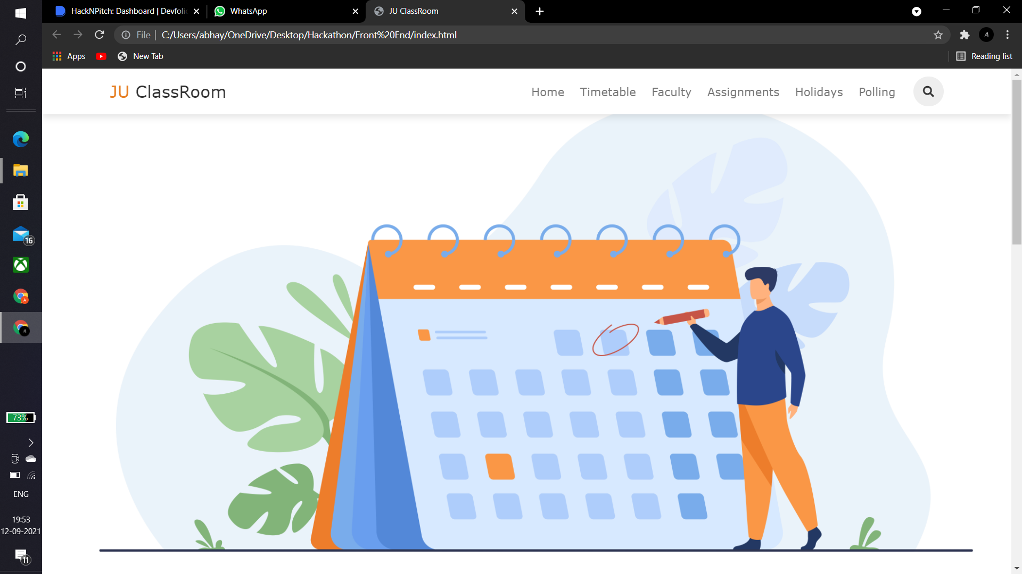
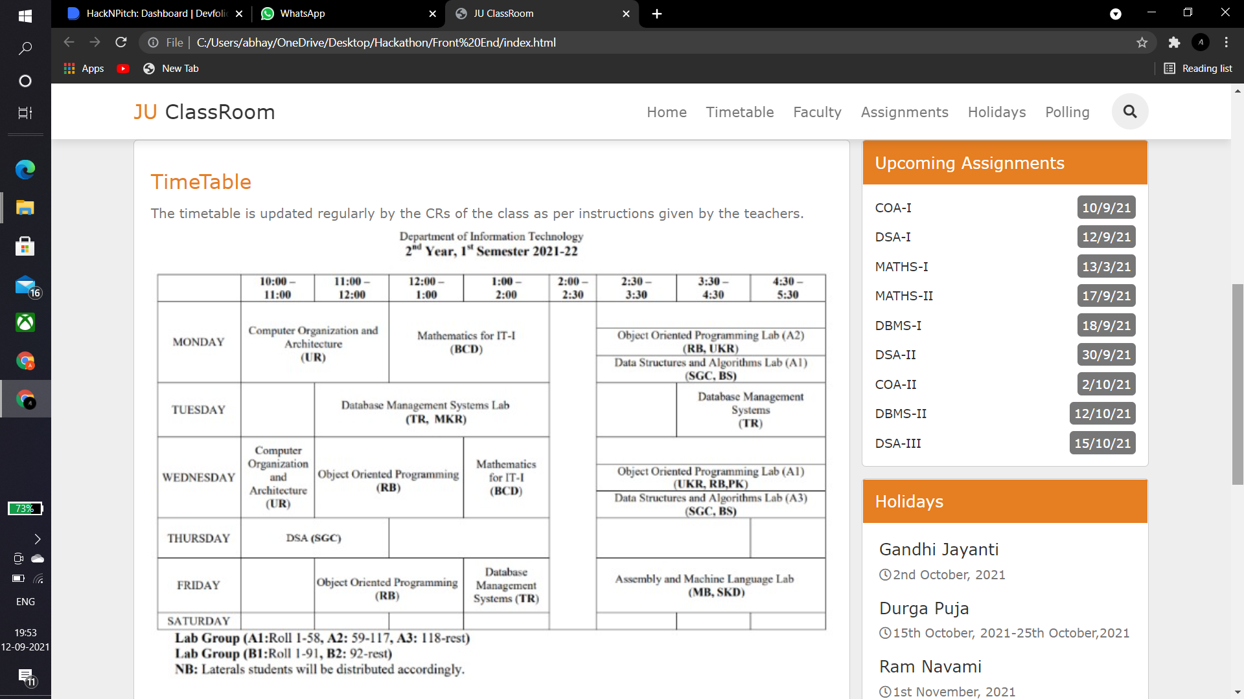
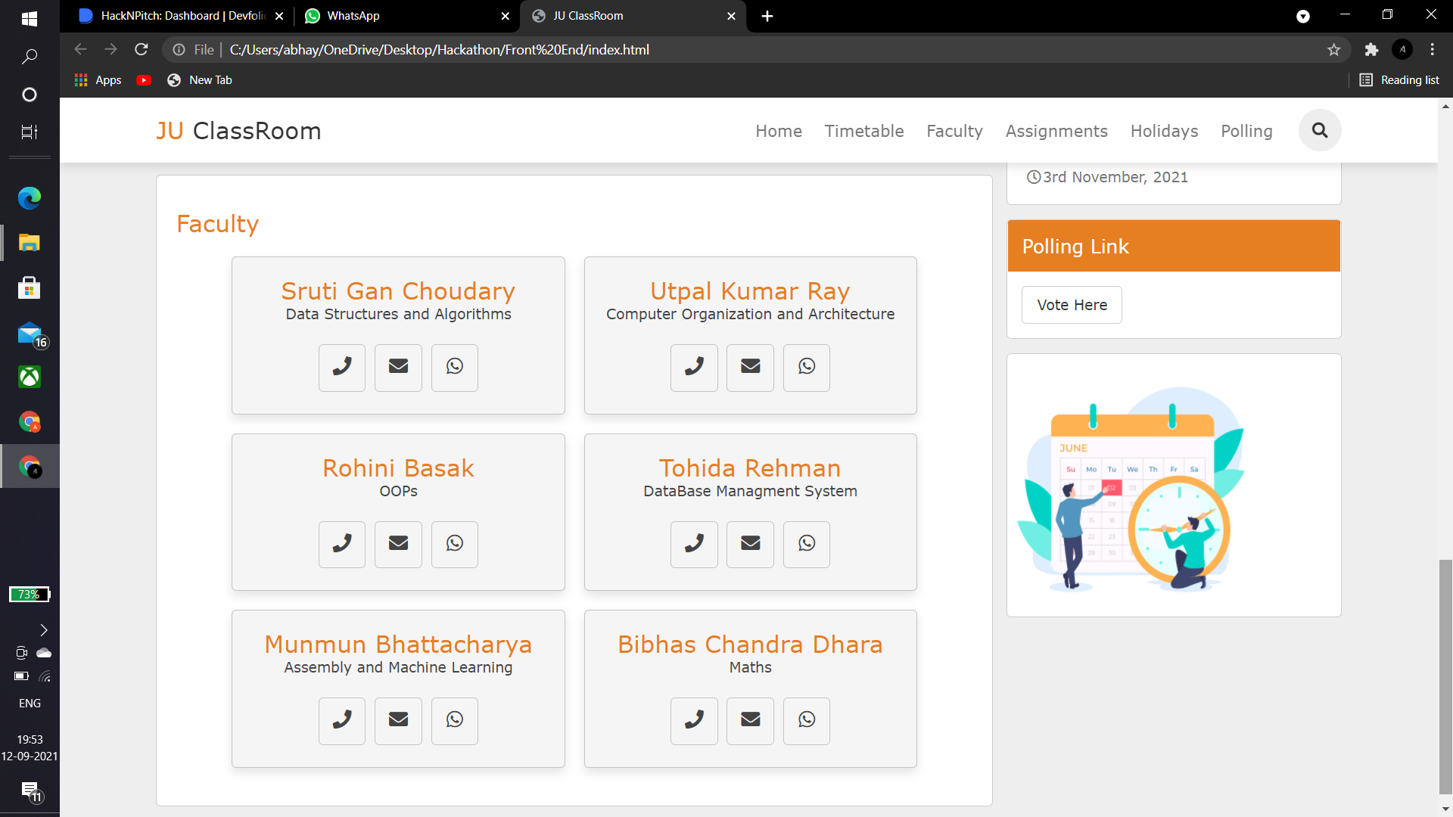
Execution plan
What will be the steps from the drawing board to the actual
prototype ?
12/9/2021
FRONT END DEVLOPMENT
The front end of the application is almost ready with some minor changes required in making it responsive
13/9/2021---20/9/2021
BACKEND DEVLOPMENT
The backend of the poduct is expected to finish by 20th keeping 1-2 days as buffer
22/9/2021
DEBUGGING
Checking the minute functionalities of the product and debugging the code if required
23/9/2021
TESTING
Testing the product in various mobile and computer devices to check responsivness and stability/load time.
HACK
N
P
TCH

